Slide 1
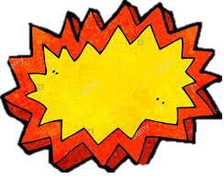

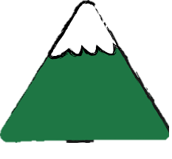
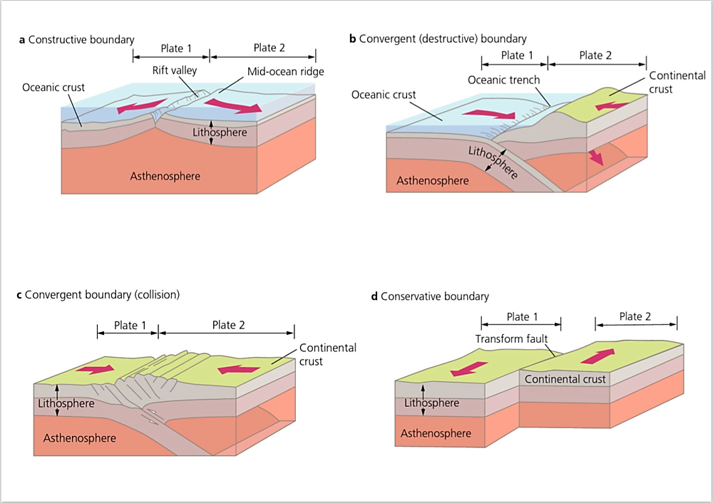
Constructive Plate Margin
Where two plates move apart from each other
Description: At constructive plate margins two plates are moving away from each other, this is what is happening at the Mid-Atlantic Ridge. Magma here is forcing its way up to the surface. As it breaks through the overlying crust it causes earthquakes and on reaching the surface it forms volcanoes such as Eyjafjallajökull The magma at constructive plate boundaries is very hot and fluid and lava erupting from a volcano will travel a long way before cooling. This results in typically broad and flat shield volcanoes.
Destructive Plate Margin
Where two plates move towards one another
Description: At a destructive plate margin two plates move towards one another such as the west coast of South America. Here, two plates meet and a deep ocean trench is formed. The oceanic (Nazca) plate which is denser, is subducted beneath the less dense continental (South American) plate. Friction between the two plates causes strong earthquakes. As the oceanic plate moves downwards it melts. This creates magma which is less fluid than that at a constructive plate margin. It is forced to the surface to form explosive composite volcanoes. These erupt in a violent and unpredictable way.
Diagram of Aquifer Storage and Recovery

Slide 2
Collision Plate Margin
Where two continental plates move together
Description: Where two continental plates meet they are both of a similar density so no plate is subducted. Instead, the two plates collide and the crust of both plates becomes crumpled and uplifted. This collision forms fold mountains such as the Himalayas. These mountain-building processes cause earthquakes. There are no volcanoes at these plate margins as no new magma is formed or forced to rise to the surface.
Conservative Plate Margin
Where two plates are moving past each other
Description: At conservative plate margins, two plates are moving past each other. Friction between the plates then causes earthquakes. A well-known example is the San Andreas Fault in California, USA. The faster moving Pacific Plate is moving in the same direction as the slower moving North American Plate. Earthquakes happen along conservative plate margins as stress gradually builds up in the crust over many years. They can be destructive as they are close to the earth’s surface. This stress is released suddenly when the plates slip and shift. There are no volcanoes as there is no magma.
Diagram of Aquifer Storage and Recovery

